Slide 1

Introducing the New System - SOCHS
We are proud to introduce our team's new system proposal with its benefits and positive impacts on your business operations. Join us as we explore the key aspects of this project.

Slide 2
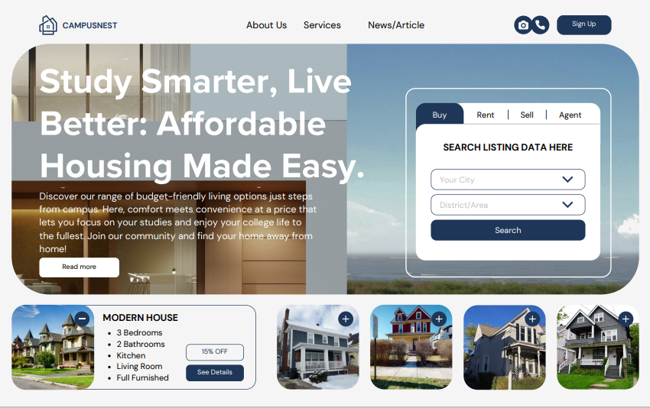
Description of the New System
Syracuse Off-Campus Housing Solutions (SOCHS)
Brokerage-Free Platform: SOCHS offers a transparent and direct connection between students and landlords, eliminating traditional brokerage fees, enhancing affordability.
Digital Integration: Advanced digital platform for easy listing, searching, and leasing processes, accessible via web and mobile interfaces.
Support Services: Includes multilingual support, legal resources, and community integration features to enhance user experience and safety.

Slide 3

Business Justification(Need for this System)
Strategic Benefits of SOCHS
Cost Efficiency: Eliminates brokerage fees, directly reducing housing costs for students and increasing affordability.
Market Differentiation: Unique brokerage-free model sets SOCHS apart, attracting more students and landlords due to its transparency and cost-effectiveness.
Enhanced Student Experience: Comprehensive support services, including legal aid and community integration, contribute to a safer and more integrated student community.

Slide 4
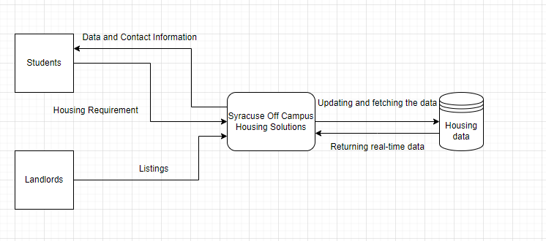
Process Model Overview
Context Diagram: Illustrates the SOCHS system's interactions with external entities like students, landlords, and service providers..

Slide 5
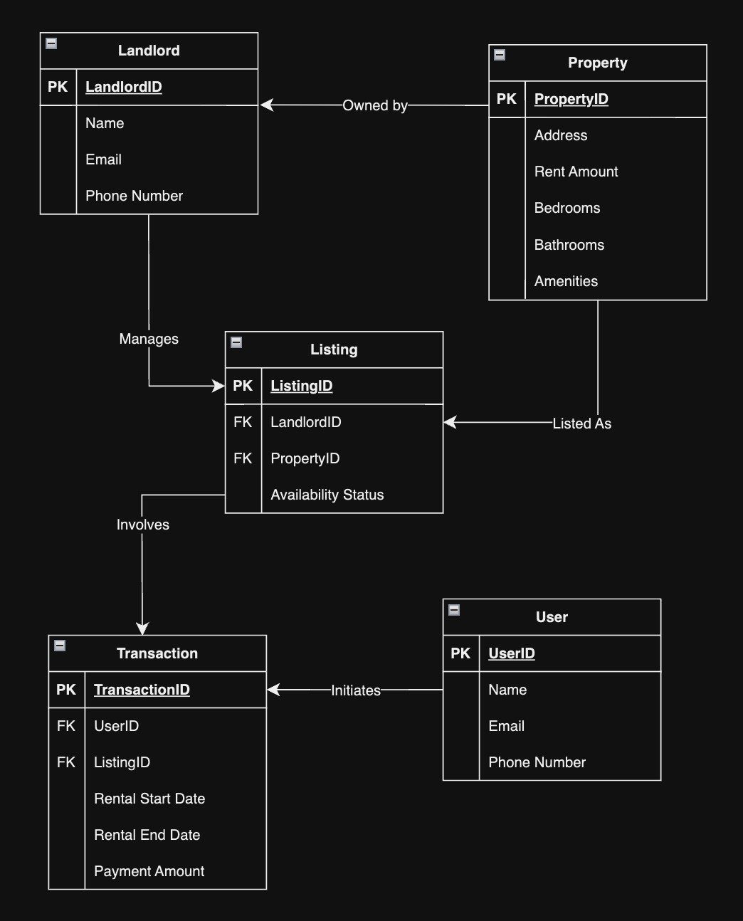
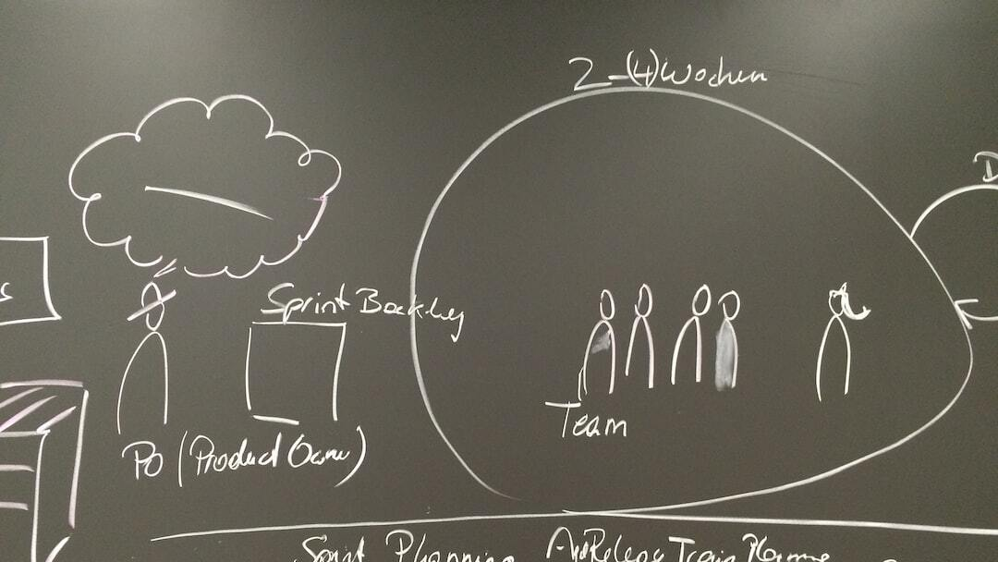
Logical Model
Entity-Relationship Diagram (ERD)
ERD Overview: Displays the structure of the SOCHS database including entities like User, Landlord, Property, Listing, and Transaction as outlined in the provided ER diagram.
Relationships: Highlights relationships between entities, such as User to Listing, and Landlord to Property, showing how they interact within the platform, according to the provided ER diagram details.
Key Attributes: Each entity’s key attributes such as UserID, LandlordID, and PropertyID, essential for system operations, as detailed in the provided ER diagram.
Photo by Ralph Hutter on Unsplash

Slide 6
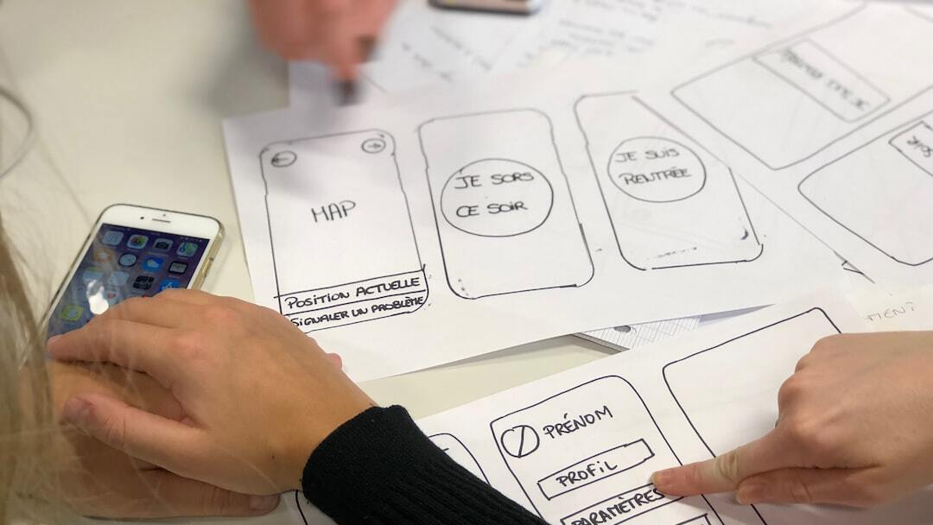
Feedback from Potential Users
User Experience Insights
Positive Feedback: Users appreciated the straightforward interface and the ease of finding housing options.
Constructive Criticism: Some users suggested improvements in search functionality and more filter options.
Suggestions for Enhancements: Feedback included requests for a roommate matching feature and better integration with campus services.

Slide 7
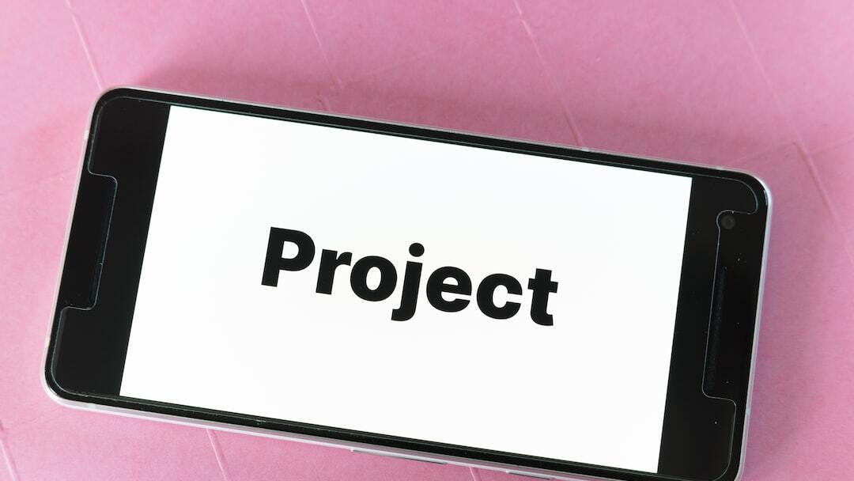
Next Steps
Testing and Implementation Considerations
Testing Phase: Finalize user testing with broader participant group to ensure system stability and usability.
Implementation Roll-Out: Gradual roll-out beginning with a pilot phase to monitor real-world usage and gather more feedback.
Marketing and Outreach: Launch targeted marketing campaigns to raise awareness among Syracuse University students and landlords.
Partnership Development: Secure further collaborations with local real estate and student organizations to expand reach.

Slide 8

Reflective Insights and Lessons Learned
Project Retrospective
Communication and Collaboration: Emphasized the importance of ongoing communication and collaboration throughout the project lifecycle.
Adaptation and Flexibility: Learned to adapt to changing requirements and project dynamics to keep the project on track.
User-Centric Approach: Focused on a user-centric approach to design and development to ensure the platform meets user needs effectively.
Stakeholder Engagement: Importance of engaging stakeholders early and continuously to align project objectives with user expectations.

Slide 9

Lessons Learned
Key Takeaways from the Project
Importance of User Feedback: Continuous user feedback is crucial for refining platform features and ensuring the system meets real-world needs.
Project Management Techniques: Effective project management strategies, such as clear communication and timely stakeholder updates, are essential for project success.
Adapting to Changes: Flexibility in project plans is necessary to accommodate unexpected challenges and leverage new opportunities.

Slide 10
QUESTIONS?
Thank you for taking the time to learn about our proposed system and project approach!

Slide 11


